Slide 1
Selenium
How to develop automated testing in web-based applications

Slide 2
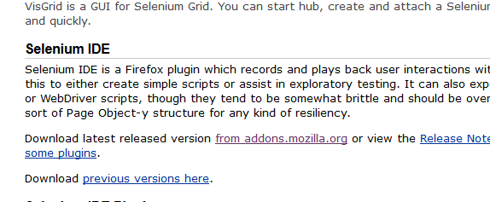
What is Selenium?
Selenium IDE is a Firefox add-on developed to allow testers and developers to record their actions as they follow the workflow they need to test.
Koder.com- source code of Selenium
Install Selenium
Go to http://seleniumhq.org/download
Click on download link for Selenium IDE Latest Version

Slide 3
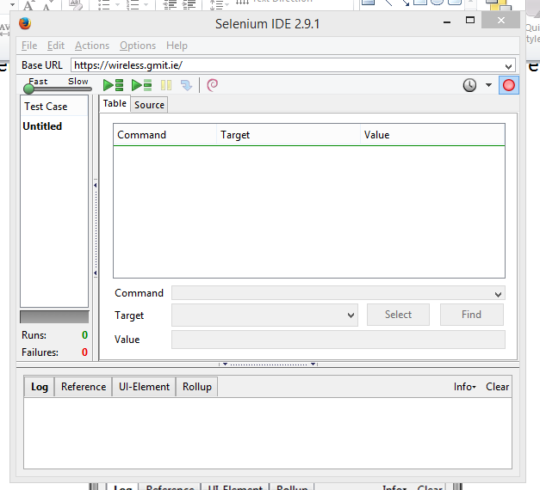
Once the installation process is complete, restart Firefox
Open up Selenium IDE by going through the Tools Menu in Mozilla Firefox

Slide 4


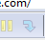
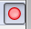
Base URL – This is the URL that the test will start. All open commands will be relative to the Base URL unless a full path is inserted in the open command.
Speed Slider- This is the slider under the Fast Slow labels on the screen.
- Runs all the tests in the IDE.
- Run a single test in the IDE.
- First Button pauses a test that is currently running and Second Button steps
through test once it has paused.
- Record Button which will be engaged when test is recording.
Command Select Box has a list of all the commands needed to create a test
Target allows you to input the location of the element that you want to work against
Uniquely identify element on a page
Find button- once the target box is populated , can be clicked on to highlight the element on the page
Value textbox is where you place the value that need to change – e.g. If you want your test to type in an input box on the web page, you would put what you want it to type in the value box.
Test table keeps track of all your commands, targets and values.
Area below Value textbox shows log while tests running – if item fails error entry.
Will also show help on Selenium commands while you work in Command select box.

Slide 5
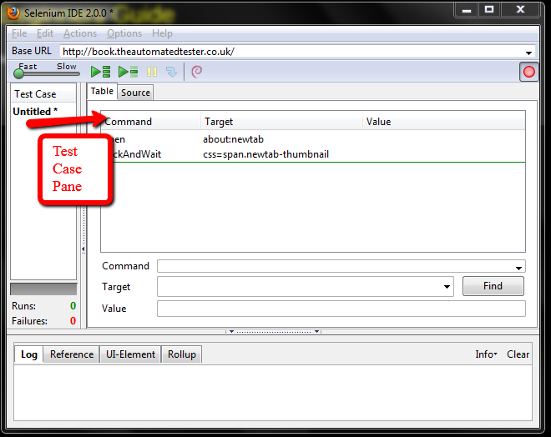
Test Case Pane
Your script is displayed in the test case pane.
It has two tabs, one for displaying the command and their parameters in a readable “table” format.(double click line to execute that line)
The other tab - Source displays the test case in the native format in which the file will be stored. By default, this is HTML although it can be changed to a programming language such as Java or C#, or a scripting language like Python.

Slide 6
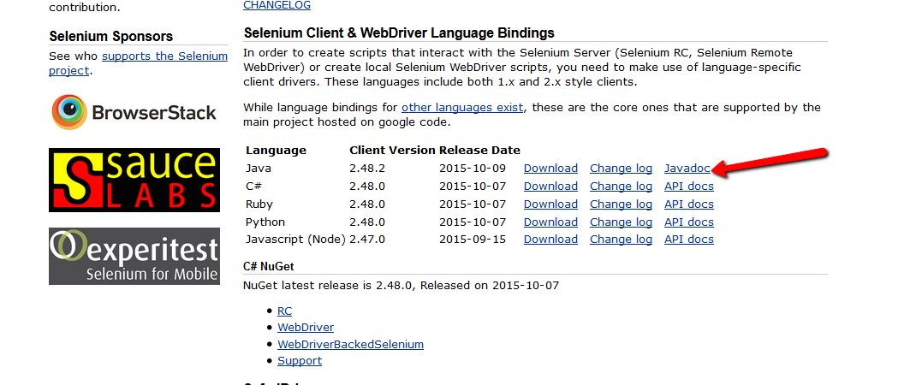
Selenium JavaDocs

Slide 7
Rules that apply to test automation
Tests should always have a known starting point.- eg opening a certain page to start a work flow
Tests should not have to rely on other tests to run.- If a test is going to add something, do not have a separate test to delete it.
Tests should only test one thing at a time
Tests should clean up after themselves.

Slide 8
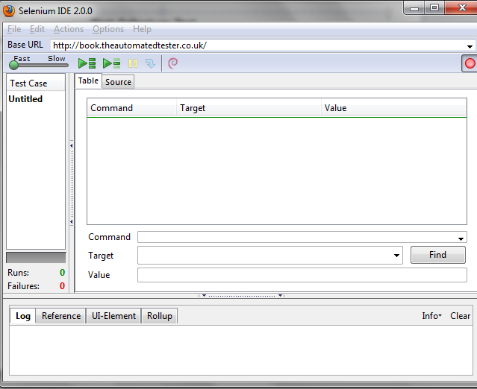
Start the Selenium IDE and change base URL:
Record button engaged when you load the IDE

Slide 9
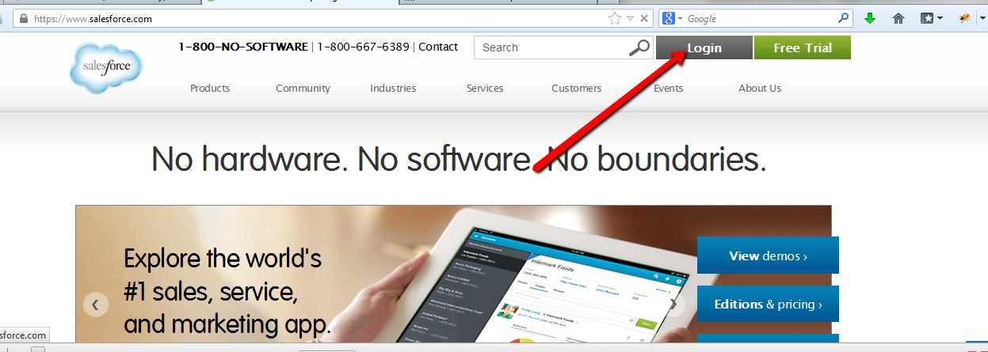
First Test

Slide 10
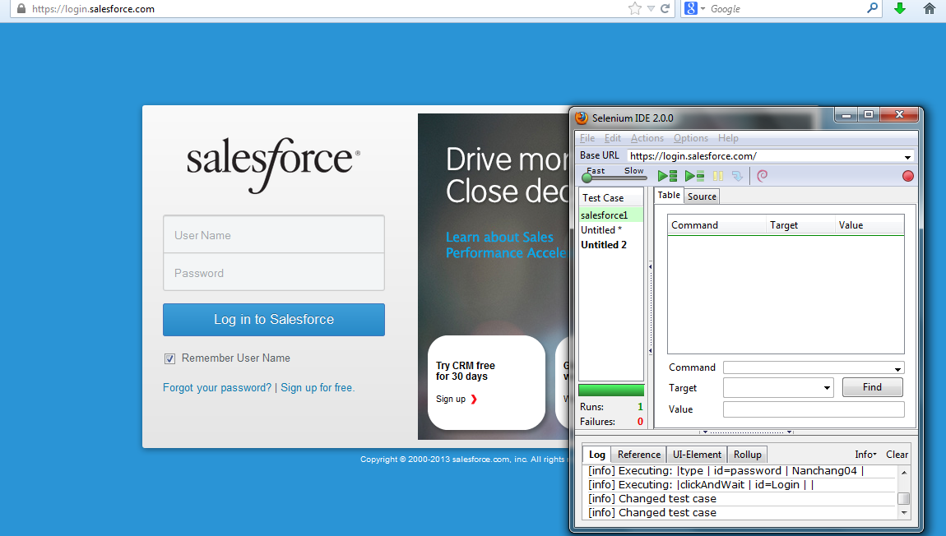

Slide 11
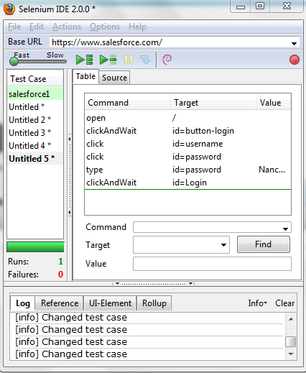
Play your test case
Turn on Firebug and you will see Xpath for LOGIN Button

Slide 12
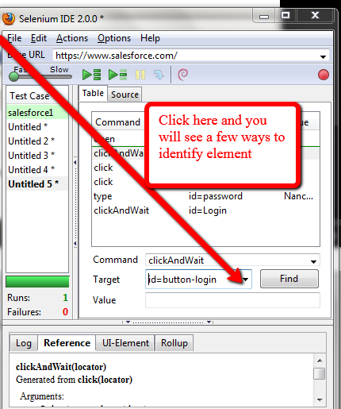
Double Click on any command and it will execute

Slide 13
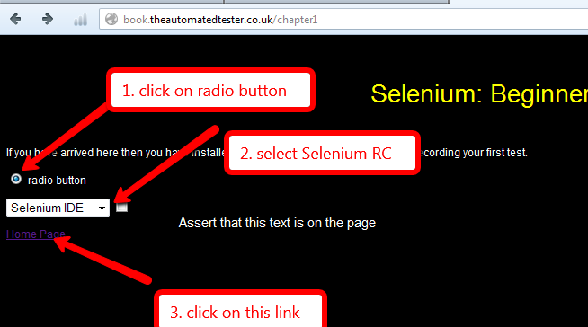
In web page- http://book.theautomatedtester.co.uk
Do the following

Slide 14
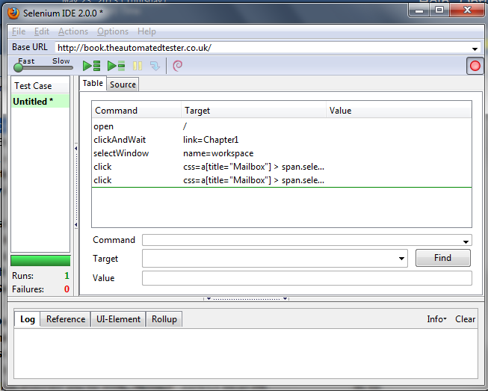

Slide 15
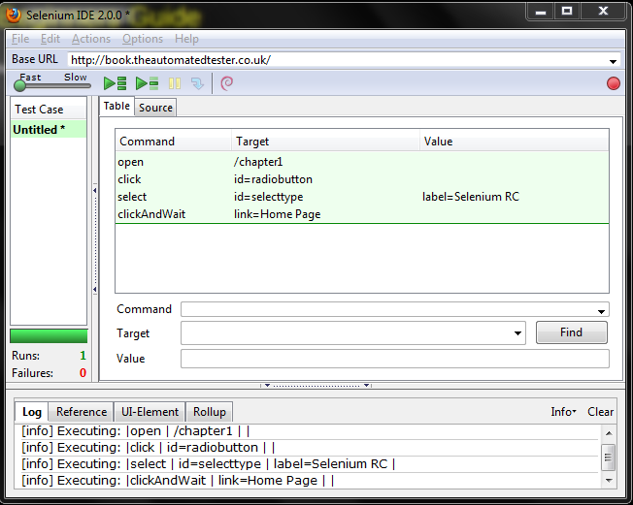
Press Play Button once the test completed- All actions have a green background and we have recorded the workflow

Slide 16
Two mechanisms for validating elements that are available on the application under test
assert: this allows the test to check if the element is on the page-If not test will stop and step is failed.
verify: allows the test whether the element is on the page but if it is not, then the test will continue executing
We need to use the context menu- right click on the element
Open IDE to start recording
Set the Base URL to http://book.automatedtester.co.uk
Click on Chapter 1
Click on the radio button

Slide 17
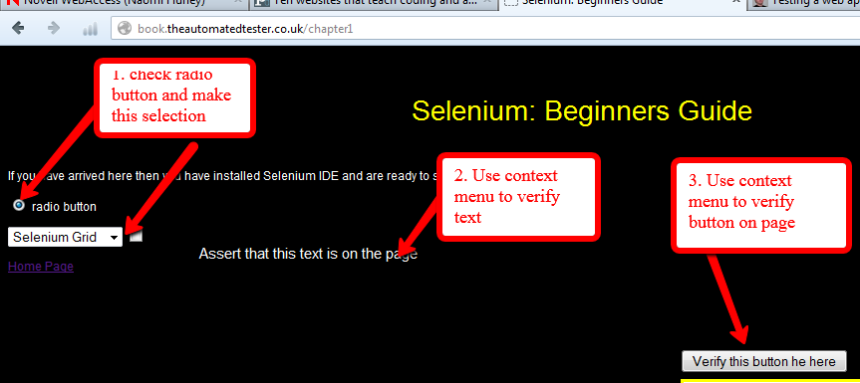
Carry out the following

Slide 18
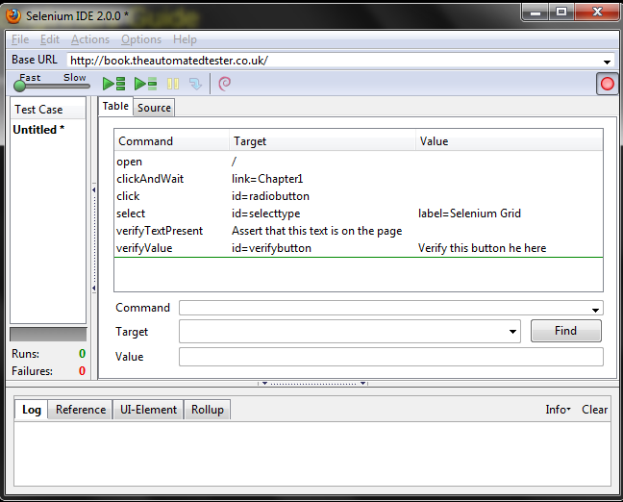
Your Selenium IDE will be similar to this:
Play test – verify commands a darker green – more important- test has checked text on page and button there too
Assert and Verify always a manual command

Slide 19
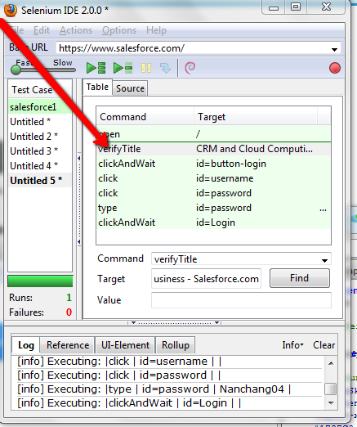
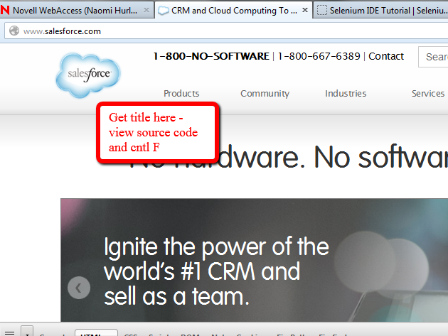
Use Verify Title – In source code – do a search for <title>

Slide 20
Exercise#1
Recreate the test you have just done but using the assert and verify methods available from Show All Commands( when you right click on Web page element)
verifyElementPresent
verifyElementNotPresent
verifyText
verifyAttribute
verifyChecked
verifyAlert
verifyTitle

Slide 21
Selenium does not implicitly wait for the item that it needs to interact with, so it is seen as good practice to wait for the item you need to work with then interact with it.
The waitFor commands will timeout after 30 seconds by default but if you need it to wait longer you cans pecify the tests by using the setTimeout command. This will set the timeout value that the tests will use in future commands.
If need be you can change the default wait if you go to Options | Options and then on the General tab and under Default timeout value of recorded command in milliseconds (30s = 30000ms) change it to what you want. Remember that there are 1000 milliseconds

Slide 22
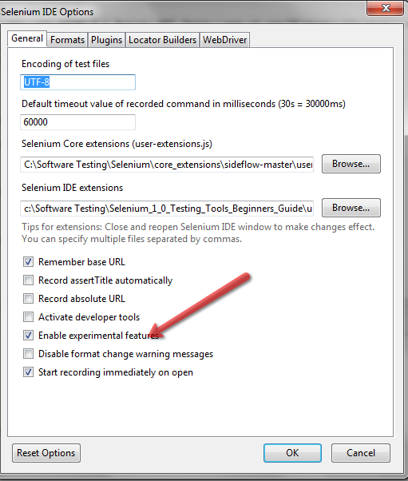
Read Source Code in Java
Last Step
Click on Format
And pick language

Slide 23
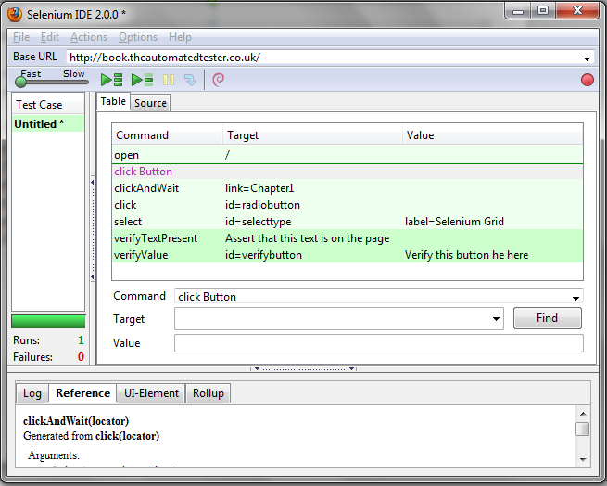
Add Comments
Pick one of your tests from Selenium IDE and right click. Pick Insert Comment and add comment to Command TextBox – You can also insert new Commands using same method

Slide 24
Multiple Windows
Open up Selenium IDE and go to the Chapter 1 page on the site.
2. Click on one of the elements on the page that has the text Click this link to launch
another window. This will cause a small window to appear.
3. Verify the text in the popup by right-clicking and selecting VerifyText id=popup text
within the popup window.
4. Once the window has loaded, click on the Close the Window text inside it.
5. Add a verify command for an element on the page. Your test should now look like
the following screenshot:
Sometimes Selenium IDE will add a clickAndWait instead of a click command.
This is because it notices that the page has to unload.
If this happens just change the
clickAndWait to a click so that it does not cause a timeout in the test.

Slide 25
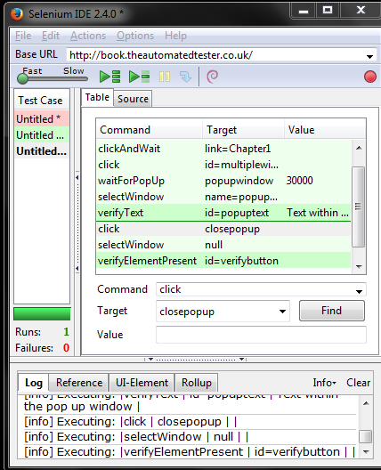

Slide 26
Two Pop Up Windows
1.Start Selenium IDE and go to Chapter 1 on the website.
2. Click on the Click this link to launch another window link. This will launch
a pop-up window.
3. Assert the text on the page. We do this by right-clicking and selecting assertText.
4. Go back to the parent window and click on the link to launch the second
pop-up window.
5. Verify the text on the page.
6. Move to the first pop-up window and close it using the close link. As before,
be aware of clickAndWait instead of click.
7. Move to the second pop-up window and close it using the close link.
8. Move back to the parent window and verify an element on that page.

Slide 27
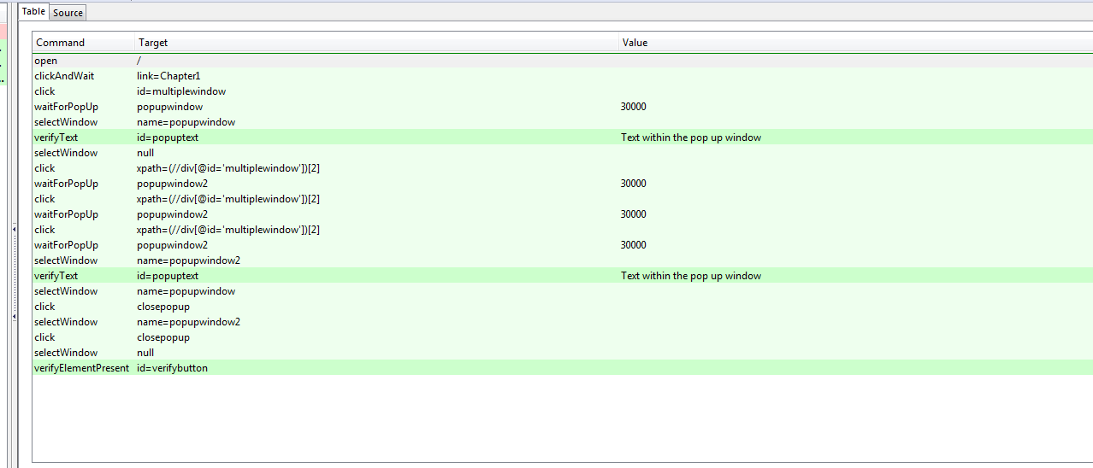

Slide 28
Locators

Slide 29
Locators
Locators allow us to find elements on a page.
Locate elements by ID
Locate elements by name
Locate elements by link
Locate elements by XPath
Locate elements by CSS
You will need to download the following:
Firebug
Download from : https://addons.mozilla.org/en-US/firefox/addon/1843
Firefinder
Download from : https://addons.mozilla.org/
Firepath
Download from:https://addons.mozilla.org

Slide 30
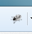

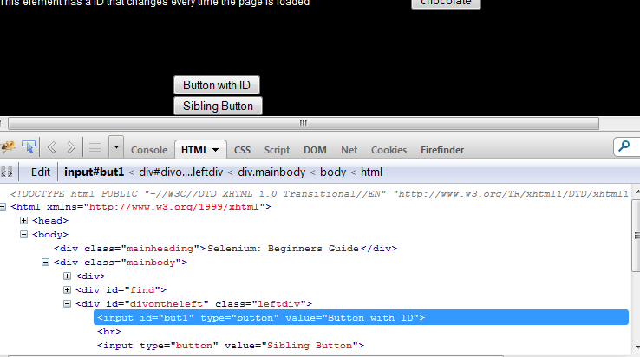
Go into Chapter 2:http://book.theautomatedtester.co.uk/chapter2
Locating elements by ID
Click on Firebug icon
Click on Page Inspect Element
Pick an element to inspect e.g. Button with ID

Slide 31
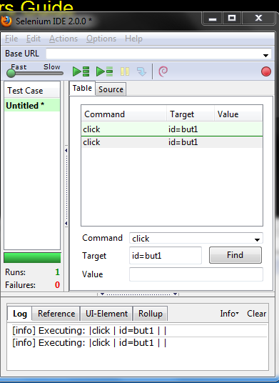
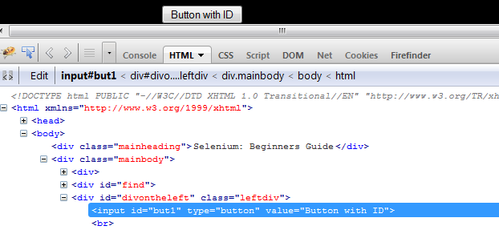
Open Selenium
Open Firebug
Find an element you want to inspect eg Chapter 2 and place its id in Target Box
Input command click in Command Box
Run Script

Slide 32
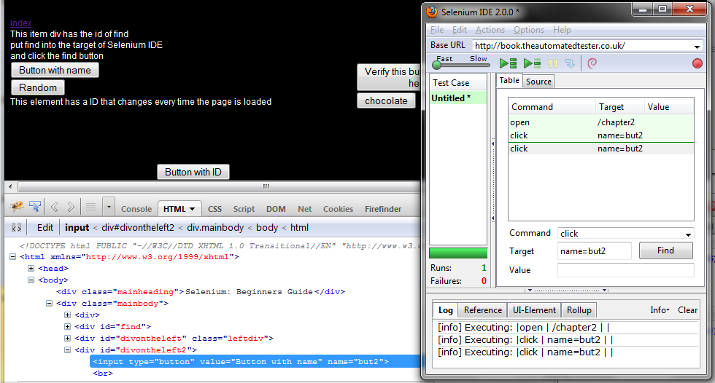
2. Locating by Name
Open Selenium
Open Firebug
Find an element to inspect –Button with Name– Place value of name attribute in Target Box and Insert command Click in Command Box. Run Script.

Slide 33
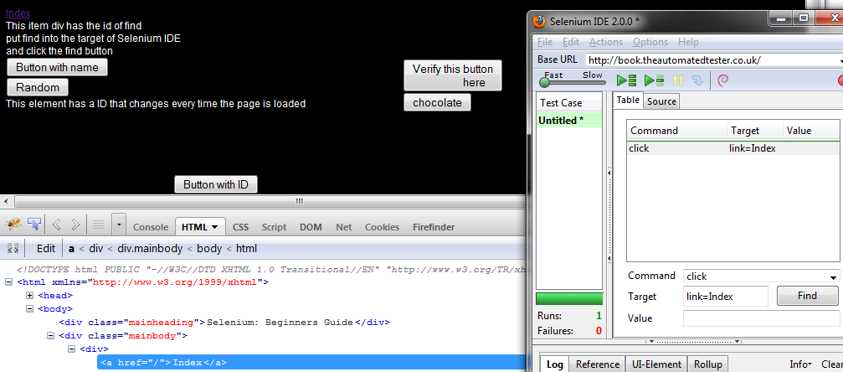
3. Locating by Link Text
Pick the Link Index. Insert Target and Command Click

Slide 34
The Document Object Model (DOM) is a programming interface for HTML and XML documents.
It provides a structured representation of the document and it defines a way that the structure can be accessed from programs so that they can change the document structure, style and content.
The DOM provides a representation of the document as a structured group of nodes and objects that have properties and methods. Essentially, it connects web pages to scripts or programming languages.
A Web page is a document. This document can be either displayed in the browser window, or as the HTML source. But it is the same document in both cases.
The Document Object Model (DOM) provides another way to represent, store and manipulate that same document. The DOM is a fully object-oriented representation of the web page, and it can be modified with a scripting language such as JavaScript.
The DOM closely resembles the structure of the documents it models.
Think of it as a structure diagram or a flow diagram of the code elements- each is a node in the DOM.

Slide 35
The Document Object Model, or DOM, is the interface that allows you to programmatically access and manipulate the contents of a web page (or document).
It provides a structured, object-oriented representation of the individual elements and content in a page with methods for retrieving and setting the properties of those objects. It also provides methods for adding and removing such objects, allowing you to create dynamic content.
Look at is like a tree... you have the <html> tag which is the root, <head> and <body> which are branches and then each of those has more branches off of it, the DOM is the representation of this tree and its various branches (so you can target children and parents of each of those areas)
It provides a way for css and javascript to interact with all every single node in a html document (HTML page has a tree structure where each element is a node.
As you change elements on your page creating structure browser interprets as DOM

Slide 36
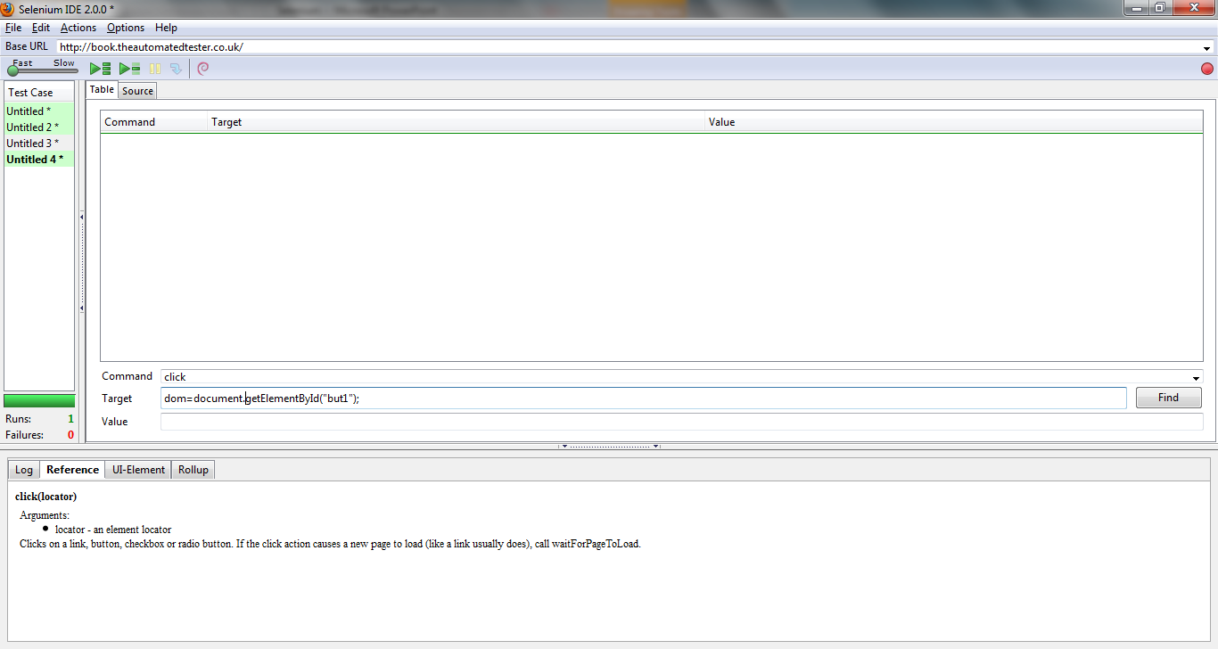
Call DOM to see if an element has been added

Slide 37
XPath is a syntax for defining parts of an XML document
Xpath shows the address of any element on a page
XPath uses path expressions to navigate in XML documents
XPath contains a library of standard functions
XPath is a major element in XSLT
XPath is a W3C recommendation
Xpath allows us to query DOM as though it were an XML document

Slide 38
4.Locating by Xpath
Finding elements by Xpath
Note you can use xpath in Firepath to find elements
Open Selenium Ide
Enter Click in the Command Selection
Enter xpath=//input into the Target box.
Run your test. Note if you click on the FIND button the element turns yellow.
In this test you looked against the DOM to find an element of type input
Element is been located by Xpath. The // tells the query that it needs to stop at first element it finds.

Slide 39
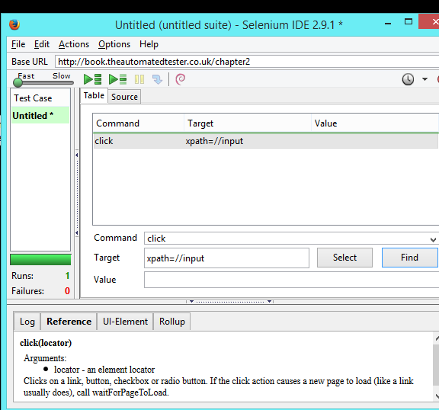
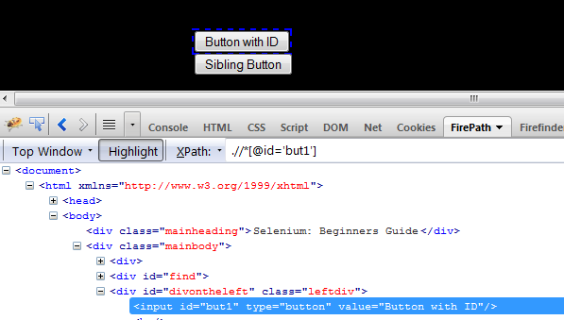
You may click on FirePath to find Xpath- Try this in your Selenium Target Box and run test

Slide 40
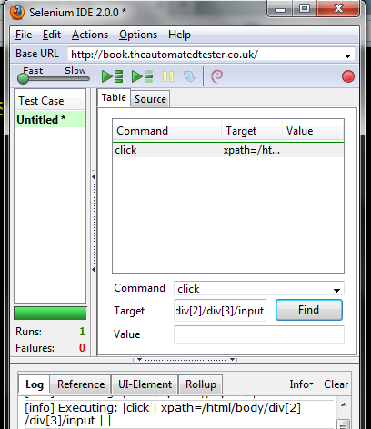
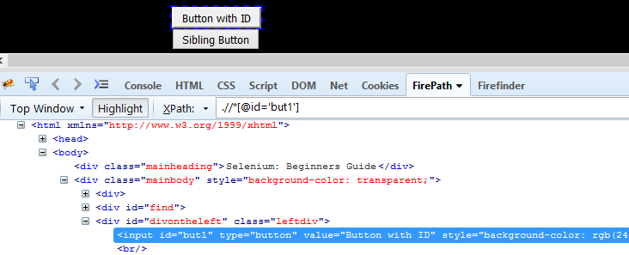
// - seen as a greedy query as it will parse the entire DOM until it finds element you want
If you want to work against an element that will always be in a certain place, use the single / but first node in query is HTML
Xpath=/html/body/div[2]/div[3]/input
Advantage – find the element fractionally quicker

Slide 41
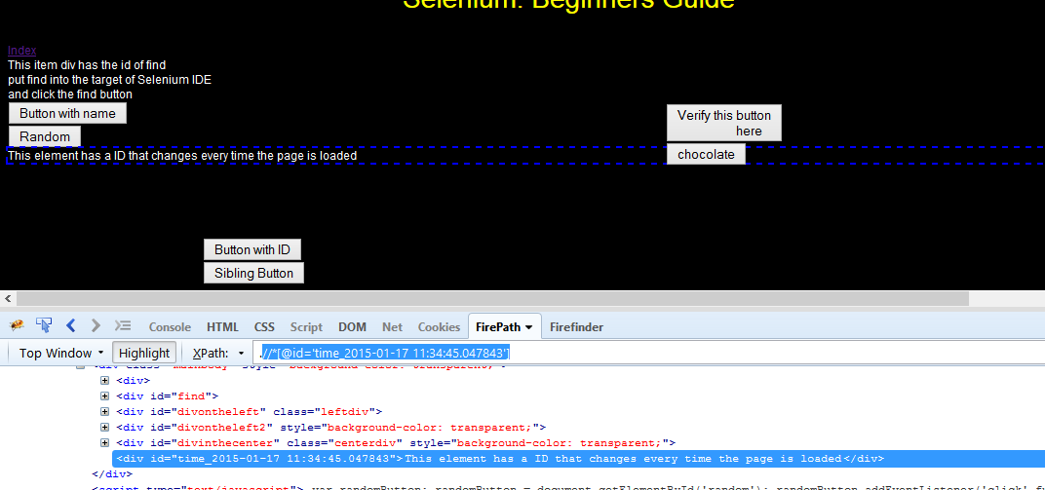

Slide 42
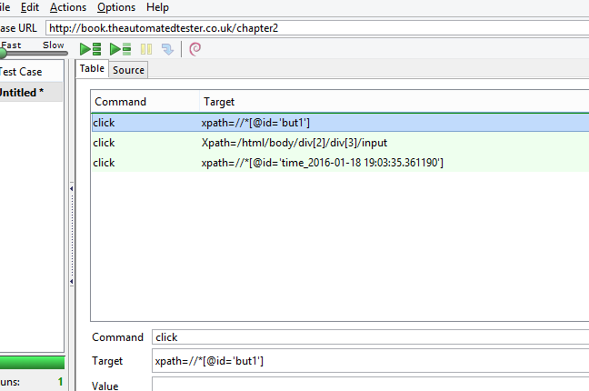
Copy in some xpaths from web site and press find button to see elements chosen
e.g

Slide 43
nodename | Selects all nodes with the name "nodename“
/ | Selects from the root node
// | Selects nodes in the document from the current node that match the selection no matter where they are
. | Selects the current node
.. | Selects the parent of the current node
@ | Selects attributes Ref: http://www.w3schools.com/xpath/xpath_syntax.asp

Slide 44
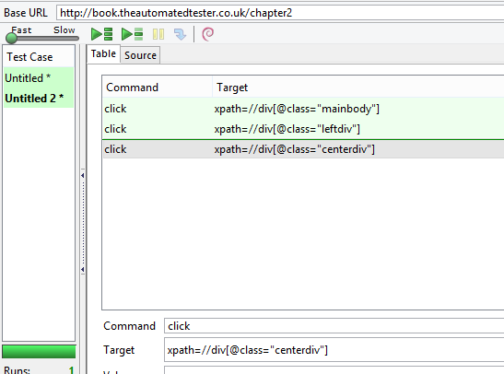
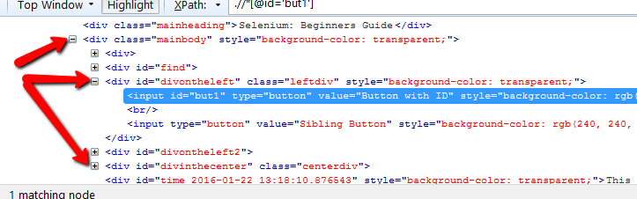
Use the //(i.e -nodes in the document from the current node that match the selection no matter where they are ) to find following:

Slide 45
EXERCISE

Slide 46
Using the single / path create three xpaths to find the following( we used // in theprevious slide)

Slide 47
SOLUTION

Slide 48
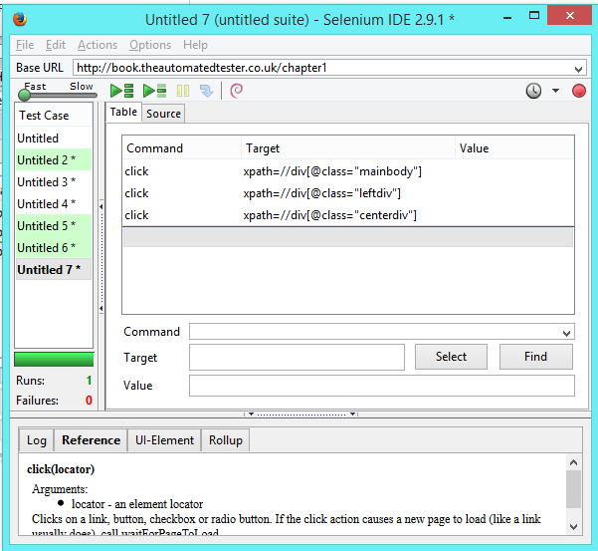
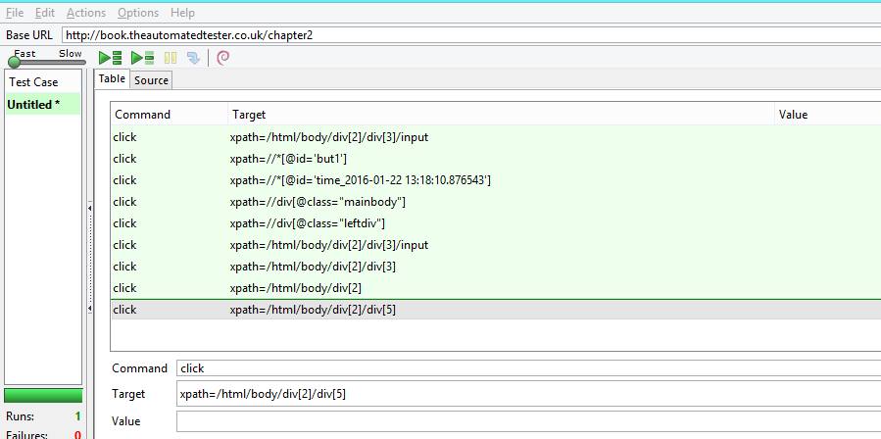
Using Element attributes XPath Queries

Slide 49
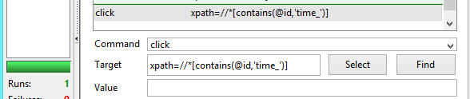
Partial Match
Doing a partial match on attribute content – use the ‘contains’ keyword
Modify the Xpath: .//*[@id='time_2016-01-22 13:18:10.876543']( remove)
To : xpath=//*[contains(@id,'time_')] - (add in)

Slide 50
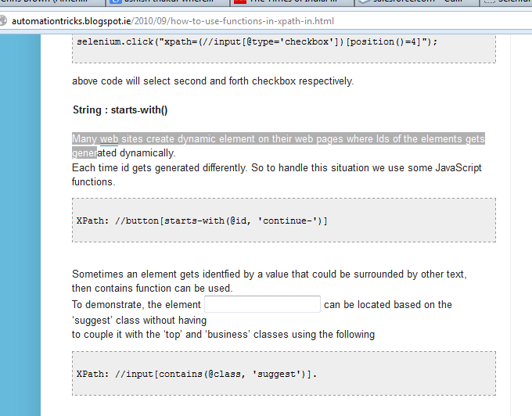
http://automationtricks.blogspot.ie/
http://automationtricks.blogspot.ie/2010/09/how-to-use-functions-in-xpath-in.html

Slide 51
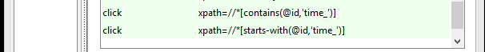
Can use starts-with

Slide 52
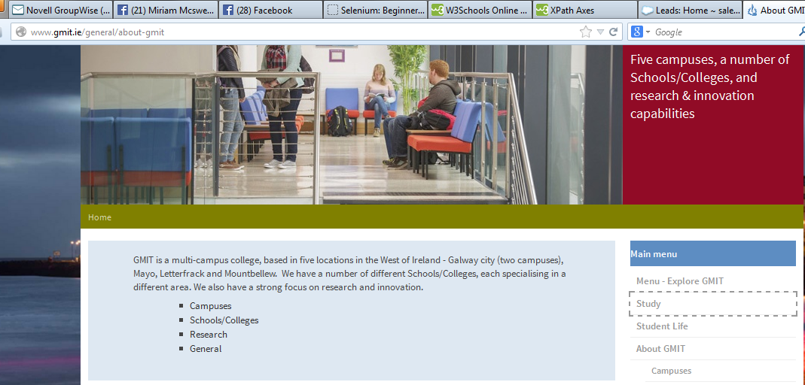
Navigate to GMIT website

Slide 53
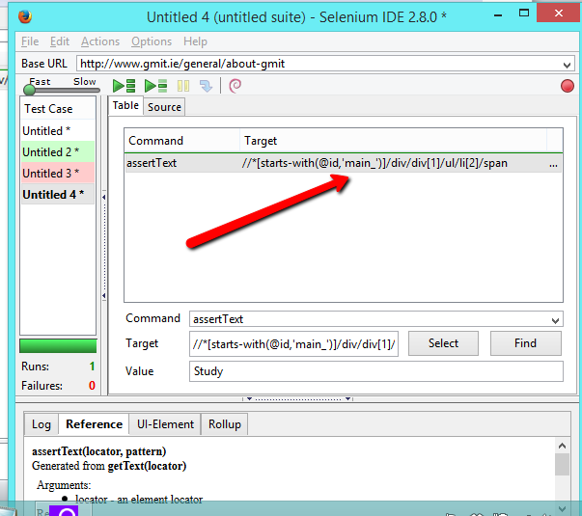
Change text to main_

Slide 54
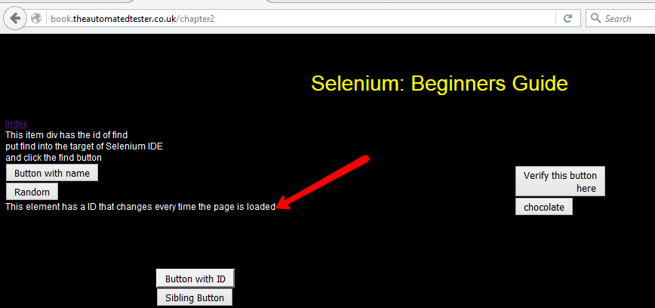

Slide 55
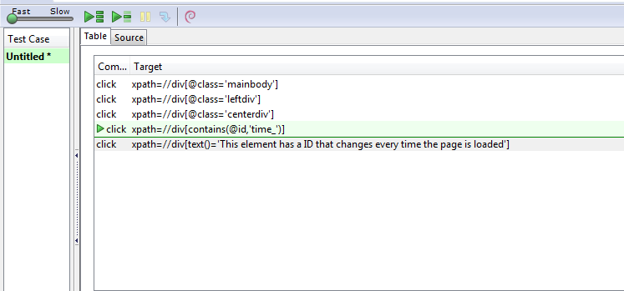
Finding an element by text it contains
xpath=//*[contains(text()='Create')]/a xpath=//*[text()='Create account']/a
Xpath =//element[text()=‘inner text’]
Xpath=//div[text()='This element has a ID that changes every time the page is loaded']
xpath=//a[contains(text(),’account’)]
xpath=//*[contains(text(),'account')]/a

Slide 56
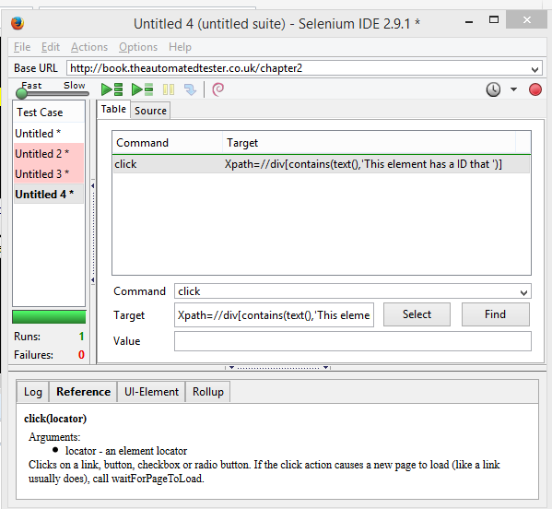

Slide 57
XPath Axes
An axis defines a node-set relative to the current node.
Ref: w3schools website
AxisName | Result
ancestor | Selects all ancestors (parent, grandparent, etc.) of the current node
ancestor-or-self | Selects all ancestors (parent, grandparent, etc.) of the current node and the current node itself
attribute | Selects all attributes of the current node
child | Selects all children of the current node
descendant | Selects all descendants (children, grandchildren, etc.) of the current node
descendant-or-self | Selects all descendants (children, grandchildren, etc.) of the current node and the current node itself
following | Selects everything in the document after the closing tag of the current node
following-sibling | Selects all siblings after the current node
namespace | Selects all namespace nodes of the current node
parent | Selects the parent of the current node
preceding | Selects all nodes that appear before the current node in the document, except ancestors, attribute nodes and namespace nodes
preceding-sibling | Selects all siblings before the current node
self | Selects the current node

Slide 58
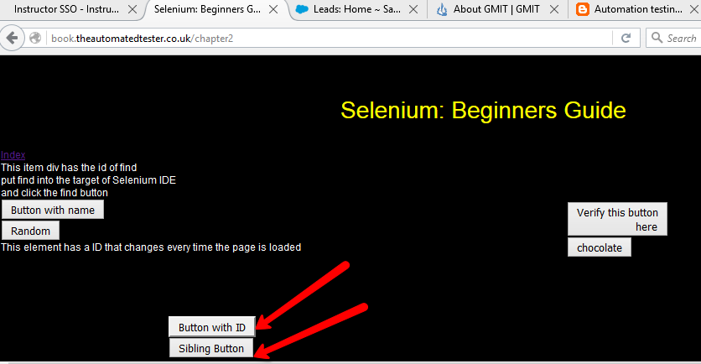

Slide 59
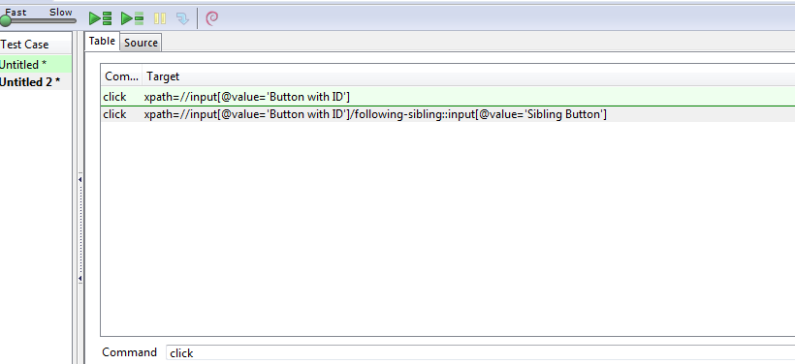
Using Xpath axis to find elements you wish to interact with
Refer to W3Schools

Slide 60
EXERCISE

Slide 61
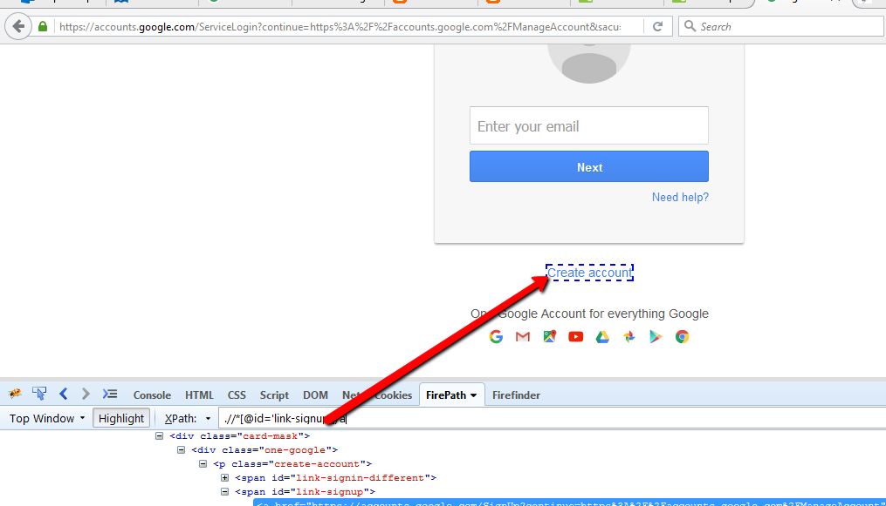
Use the following web address: https://accounts.google.com(GMAIL)

Slide 62
Using contains and starts-with:
Syntax: contains
To find the “Create account” hyperlink, consider the following variations of contains() method.
By Text
– //a[contains(text(),’Create’)]
– //a[contains(text(),’ account’)]
By Attribute
– //a[contains(@id,’signup’)]
– //a[contains(@id,’link-signup’)]
– //a[contains(@id,’link’)]
2. Syntax: starts-with() Syntax:
To find the “Create account” hyperlink, consider the following variations of starts-with() method.
By Attribute
– //a[starts-with(@id,’link-si’)]
– //a[starts-with(@id,’link-sign’)]
Ref: http://www.protechskills.com/testing/automation-testing/selenium/usage-contains-starts-functions-xpath

Slide 63
SOLUTION

Slide 64


Slide 65


Slide 66


Slide 67


Slide 68


Slide 69


Slide 70



Slide 71

5. CSS Selectors
Open Firebug
Click on FireFinder Tab

Slide 72

In Selenium do the following

Slide 73
EXERCISE

Slide 74

Find the “link” using Firefinder

Slide 75
SOLUTION

Slide 76


Slide 77


Slide 78

Using sibling nodes to find the element
Finding elements by using a sibling node in the DOM is the most common way to access an element
# is an id selector, used to target a single specific element with a unique id
Create a CSS selector to find second button – Sibling Button

Slide 79

Using the div tag

Slide 80

Using Element Ids in CSS selectors
To find an element by ID in a CSS selector, place a # in front of the ID( Chapter 2)

Slide 81
EXERCISE

Slide 82


Slide 83
SOLUTION

Slide 84


Slide 85

Finding elements by their attributes
Look for button with value chocolate- syntax- node[attribute=‘value’]

Slide 86

Find element by href – syntax a[href=‘path’]
Find a link to chapter from index page: - Go back to main page:http://book.theautomatedtester.co.uk/
Chaining of attributes supported: syntax-css=node[attr1=‘value’][attr2=‘value2’]
e.g. css=input[id=‘but1’][value=‘Button with ID’]

Slide 87
Partial Matches on attributes
In XPath use contains
For CSS:
Syntax | Description
^= | Finds the item starting with the value passed in. This is equivalent to the XPath starts-with
$= | Finds the item ending with the value passed in. This is equivalent to the XPath ends-with
*= | Finds the item that matches the attribute, which has the value that partially matches. This is equivalent to the XPath contains

Slide 88

In XPath we had //div[contains(@id,’time_’)] which has a dynamic ID.
The equivalent CSS selector is( both work)

Slide 89

contains

Slide 90

Finding the nth element with CSS
In the Xpath example, looked at the second input after the div with the class leftdiv
Xpath=//div[@class=‘leftdiv’]/input[2]
CSS Equivalent: Note – Selenium does not support the nth of type pseudo class so you will not be able to select specifc types

Slide 91

Finding an element by its inner text
Earlier we had xpath=//div[contains(text(), ‘element has a ID’)] to find a div with text in it
Equivalent CSS

Slide 92

Pattern Matching
Verifying exact text- Place prefix exact: in front of item
Go to this URL:http://book.theautomatedtester.co.uk/chapter3/yourname
Do the following –Now Run your test

Slide 93

Using exact: on links
Go to http://book.theautomatedtester.co.uk/chapter3
We are testing link Index and using exact prefix-Run test

Slide 94

Using globs in our tests
Globbing – you want to test something in a div but surrounding text might change suddenly
Navigate to http://book.theautomatedtester.co.uk/chapter3
Run following test to verify Virgo star sign present.

Slide 95

Check for match “Cap”

Slide 96

Check for one character difference – Use the ? Character

Slide 97

Using character classes in Globbing
If we want just to check if certain characters in word

Slide 98

Using Basic Regular Expressions
Globbing – does not allow to check for numbers or ignore capitalisation
Use regular expressions by putting regexp: in front of string we want to check
\w – looks for word characters
\d – looks for digit characters
[ ] -tells expression how many times it should expect each type

Slide 99

Using regular expression wildcards
http://book.theautomatedtester.co.uk/chapter3/yourname

Slide 100

Using JavaScript
To specify something is going to contain javascript you need to put javascript{ } into the target or value box
Go to http://book.theautomatedtester.co.uk/chapter4

Slide 101
Using JavaScript

Slide 102

Using Multiple Statements in JavaScript- Current Hour returned to Selenium

Slide 103

Storing the result of JavaScript in a variable

Slide 104

JavaScript within a verify or assert
In IDE create a step to store text in bid
Create a step to verify it is equal to 5*10 using verifyEval command

Slide 105

Using Selenium variables with JavaScript

Slide 106
Command: echo Target: ${a} This will print value of variable ‘a’ that is 1000 to the log. Note: * If you simply give 'a' in the target instead of '${a}' then this is treated as a string/Character and 'a' is printed to log but not its value. *All the variables declared in a test are stored into an array called "storedVars". In order to refer value of variable inside storedVars array, you can call Target: javascript{storedVars['a']}
The + in front of storedVar changes it from a string to an integer.
Ref http://www.questionselenium.com/2012/10/
SELENIUM Java Docs (APIs) http://selenium.googlecode.com/git/docs/api/java/index.html

Slide 107


Slide 108


Slide 109


Slide 110


Slide 111


Slide 112


Slide 113
Accessing the Browser with JavaScript
Selenium is built from JavaScript
Selenium wraps the DOM in a new object- If you want to access the DOM in your test without using a specific Selenium command, you will need to access it through a special object called a BrowserBot.
BrowserBot has access to the browser window. It is the JavaScript object that allows Selenium control the browser. It overrides access to the window, document and other key browser JavaScript objects that we can normally access
Your test will need to call the window and you will have the Window object with which you can do what you want
Syntax: var window= this.browserbot.getUserWindow();
getUserWindow() returns Window object

Slide 114

A simple experiment where we concatenate two strings and verify that they equal what we think they should.

Slide 115


4 options to select from

Slide 116
Firing Events
You may not be able to click on an element on the page
You need to make your test fire the click event
Selenium has an API call that allows us to fire the event that is attached to elements on a page
<div id=‘FireEventDiv’ onClick=‘alert(“AlertThrown”)’>
The fireEvent call specifying onClick on the above div would cause the alert to be thrown/ The fireEvent works against the following JavaScript events:
onFocus
onBlur
onChange
onSubmit
onMouseOut
onMouseOver
You want to test a mouseOver but Selenium command mouseOver does not make your mouseOver fire. Test the event using the fireEvent command

Slide 117


Firing onmouseover event
mouseover (event) Fires when the user moves the mouse over the element you registered the event on or one of its descendants.

Slide 118

Firing onblur event
blur ( event) Fires when a focusable element loses the focus

Slide 119


Slide 120
User Extensions

Slide 121

http://www.seleniumhq.org/docs/

Slide 122


Slide 123


Slide 124


Slide 125

Scroll to end of page

Slide 126


Slide 127


Slide 128


Slide 129

Check out the while function in user-extensions.js file

Slide 130

Check out the while function in user-extensions.js file

Slide 131


Slide 132

Add the following function to your user-extensions.js file
Any time you change this file you must restart the Selenium IDE

Slide 133


Slide 134

Change to website ‘Accounts.Google.com’
Add following function to user-extensions.js file
Selenium.prototype.doGenerateRandomEmail = function(locator){
alert("Starting to generate a random email id");
selenium.doType(locator,“naomihurley24@gmail.com");
}
RESTART SELENIUM IDE each time you change user-extensions file

Slide 135



Slide 136
Enter following code into user-extensions.js
Selenium.prototype.doGenerateRandomEmail = function(locator){
//alert("Starting to generate a random email id");
//using selenium object
var allowedChars = "abcdefghijklmnopqrstuvwxyz";
var stringLength=8;
var randomstring=‘’; //use double if single don’t work
for(var i=0;i<stringLength;i++){
var rnum=Math.floor(Math.random() * allowedChars.length);
randomstring += allowedChars.substring(rnum,rnum+1);
}
//append to gmail
randomstring+="@gmail.com“
selenium.doType(locator,randomstring);
}

Slide 137


Slide 138

Go to following site

Slide 139

Include this function in user-extensions.js file
Selenium.prototype.doCalculateSum = function()
{
var text=storedVars['addition'];
//2+4=
var arr=text.split(" ");
// you may comment out these
//alert([0]);//2
//alert([1]);//+
//alert([2]);//4
//alert([3]);//=
var sum =new Number(arr[0])+ new Number(arr[2]);
alert("The sum is"+sum);
selenium.doType("//*[@id='mathuserans2']",sum);
}

Slide 140


Slide 141
Create a New Lead using Salesforce site

Slide 142

Create a new Lead in Salesforce- Turn on Selenium IDE and record

Slide 143

Record & Run Test

Slide 144

Assert Text

Slide 145


Slide 146


Slide 147
Testing Popups

Slide 148

Testing Popup

Slide 149



Slide 150

Need to tell Selenium control going from main window to popup window- Id of window changing constantly so safest thing to do is

Slide 151



Slide 152


Slide 153


Slide 154

Now transfer control back to main window

Slide 155



Go into Calendar

Slide 156
Attaching File

Slide 157

Attach File

Slide 158



Slide 159


Slide 160


Slide 161

Selenium cannot click on these files- they are not web based-windows based

Slide 162

Copy the pathname of the file you wish to attach

Slide 163


Slide 164


Slide 165


Slide 166


Full Set of Commands to Create a Task and Attach a File

Slide 168
Handling Java Script Alert Messages

Slide 169



Slide 170


Slide 171
Parameterisation of Test Cases

Slide 172
Parameterisation - Read data from XML file into Selenium IDE
Use two files – user-extensions.js and TestData.xml(stored in Software Testing/Selenium/qtp/ide_code/
In user-extensions file modify following function so that dataFIlePath can see the XML file
function xmlTestData() {
this.xmlDoc = null;
this.testdata = null;
this.testRepeatCount= 0;
this.dataFilePath = "file:///C:/Software Testing/Selenium/qtp/ide_code/TestData.xml";
this.testName=null;
}

Slide 173

Open up IDE – Go into options and upload newly saved user-extensions.js from location where you have saved file

Slide 174

Key in commands and play test case – File reading from xml file

Slide 175


Slide 176


Slide 177

Change test to CreateLeadTest

Slide 178
CREATE A TEST CASE TO LOGIN TO SALES FORCE WEBSITE

Slide 179
Modify Test Data xml file and just keep one entry with your login details which allow you to access SalesForce site.
Note: Insert your valid user name and password into the LoginTest.
<testdata>
<LoginTest>
<TestData>
<username>naomi.hurley@gmit.ie</username>
<password>YourValidPassword</password>
</TestData>
</LoginTest>

Slide 180

Take steps to go through Login to Salesforce website

Slide 181
Ensure data path written into user-extension file
function xmlTestData() {
this.xmlDoc = null;
this.testdata = null;
this.testRepeatCount= 0;
this.dataFilePath = "file:///C:/Software Testing/Selenium/qtp/ide_code/TestData.xml";
this.testName=null;
}

Slide 182
CREATE TWO TEST LEADS SALESFORCE

Slide 183


Slide 184


Slide 185


Slide 186

Delete Lead Test Case
Now close your browser- run 3 test cases in order – Login; Create Lead and Delete Lead

Slide 187


Slide 188

This the test case base URL

Slide 189

Revision – Inserting a complete new lead in salesforce
This the test case base URL
Make sure the check box is not enabled

Slide 190

Inspect each element and use the element’s Xpath in the firebug dialog

Slide 191


Slide 192
Lab Assignment
Change the last selenium test case to use input for the TestData XML file rather than inputting the data directly into Selenium

Slide 193


Slide 194


